Slide 1

Text Extraction from store bills

Slide 2


Project Leadership
Bharani Kumar Depuru
Director & Co-Founder at Innodatatics
llinkedin.com/in/bharanikumardepuru
Sharat Manikonda
Director at Innodatatics and Sponsor
linkedin.com/in/sharat-chandra

Slide 3

Project Mentor
Sree Priya Naroju
Intern at INNODATATICS
linkedin.com/in/sree-priya-naroju

Slide 4

Participant
Name
Intern at INNODATATICS
https://www.linkedin.com/in/katari-adithya-3667121a7/

Slide 5

Contents
Business objective
Business Constraints
Project Architecture
Data collection and details
Exploratory Data Analysis
Visualization
Modeling
Evaluation
Deployment
Notes:
Change

Slide 6
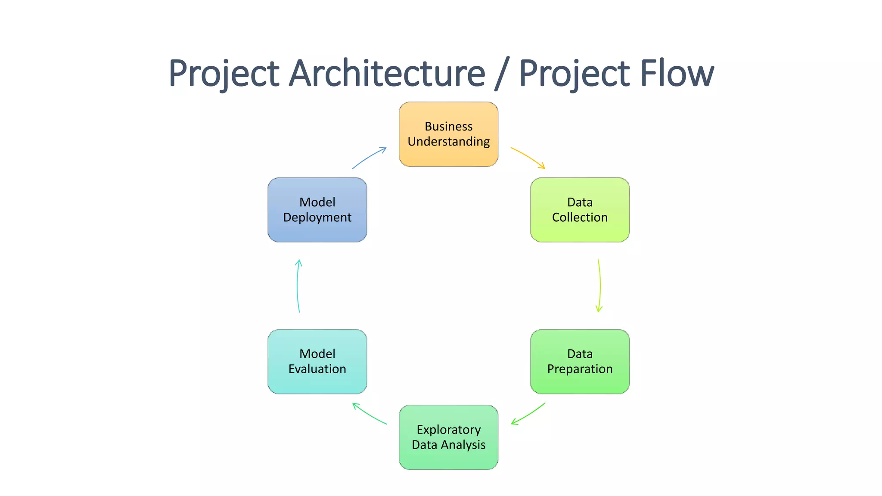
Project Overview and Scope

Slide 7
Business Problem Manually doing data entry of the entries available on retail store bills will be extremely time consuming and is prone to human errors.

Slide 8
Business Objective
Objective
Constraints
Minimize the time taken to extract the text
Minimize the manual effort

Slide 9
CRISP-ML(Q) Methodology
There are six stages of CRISP-ML(Q) Methodology
1.Business and data understanding
2.Data preparation
3.model building
4.Model evaluation
5.Model deployment
6.Monitoring and maintenance

Slide 10





Technical Stacks
Streamlit: Used for model deployment
MySQL: Used for creating databases and retrieving data
Python : Used for model building
Anaconda: Open source python distribution
Jupyter: Python IDLE

Slide 11
Data Collection and Understanding
Collecting Invoice bills you want to extract text from DMart.
All the images are provided in jpeg format.
Data must be of sufficient quality to enable accurate OCR.

Slide 12
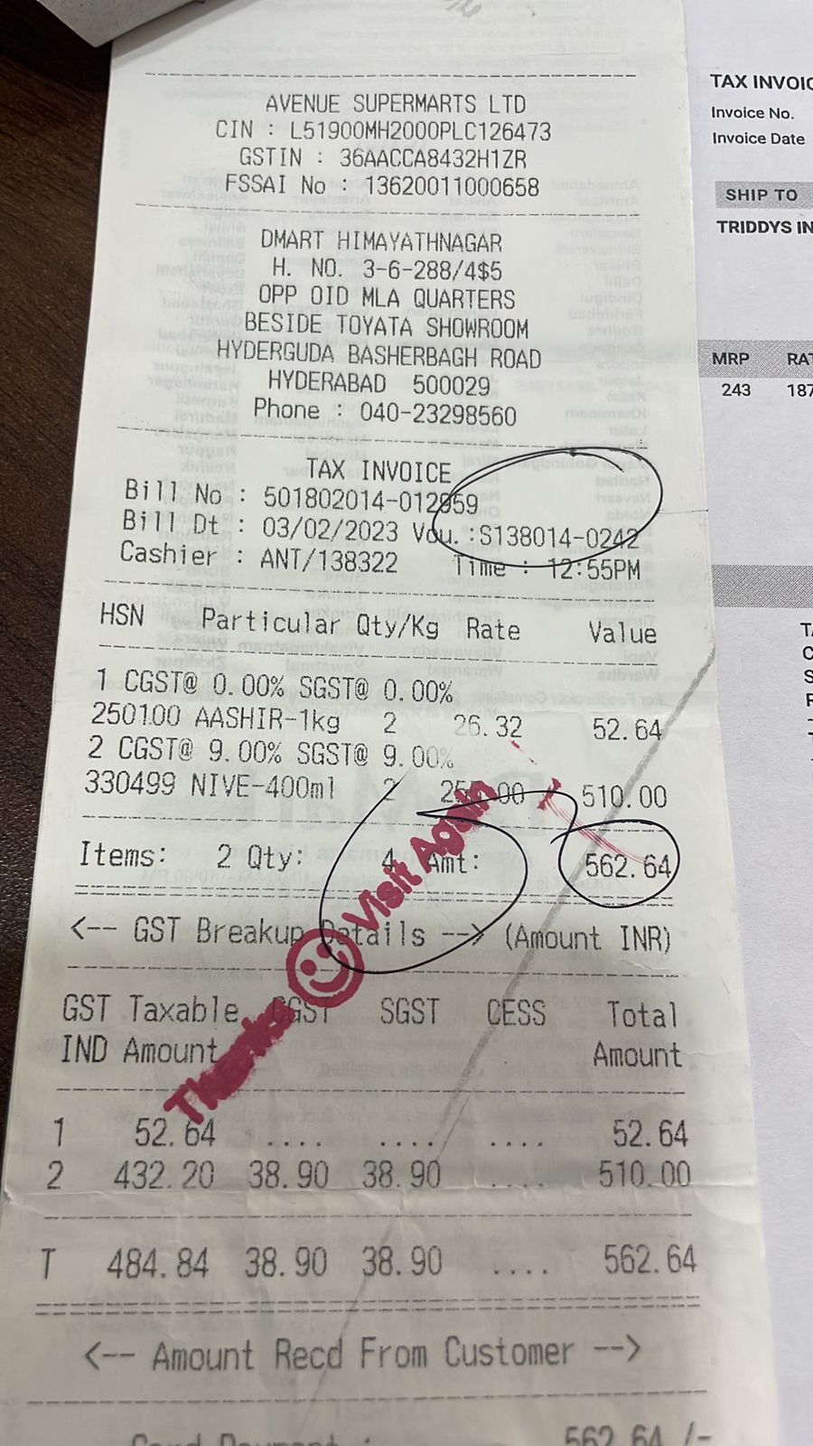
Data Information
DMart invoice bills contains following fields:
Bill Number
Bill date
Product name
Quantity
Rate
Value

Slide 13
Data Dictionary
Bill Number = A unique identifier for a particular invoice
Bill date= The date that a bill is issued
Product name= Name of product
Quantity= Number of a material
Rate = Amount per 1 product
Value = Amount to be paid for all products

Slide 14
System Requirements
Windows 10
I7 processor
GPU

Slide 15
Data Preprocessing
Grayscale Conversion: converting images to grayscale can simplify the data preprocessing and reduce the computational complexity. Grayscale images have a single channel (intensity), compared to RGB images that have three channels (red, green, and blue).
Resizing: Images in a dataset may have different sizes, so resizing them to a consistent size is often necessary. This can be achieved by resizing images to a specific width and height, or by maintaining the aspect ratio while scaling them.
Notes:
Keep observations

Slide 16
Data Preprocessing
Image Enhancement: Techniques like contrast stretching, histogram equalization, and sharpening can be applied to enhance the visual quality of images and improve their features' visibility. These methods adjust the brightness, contrast, and sharpness of the image.
Noise Removal: Images may contain various types of noise, such as Gaussian noise, salt-and-pepper noise, or speckle noise. Applying denoising techniques like median filtering, Gaussian filtering, or bilateral filtering can help reduce the impact of noise on image analysis.

Slide 17
Model Building
Tessaract OCR = Tesseract is an open source text recognition (OCR) Engine, available under the Apache 2.0 license. It can be used directly, or (for programmers) using an API to extract printed text from images. It supports a wide variety of languages. Tesseract doesn't have a built-in GUI, but there are several available from the 3rdParty page.
Easy OCR=EasyOCR is actually a python package that holds PyTorch as a backend handler. It detects the text from images but in my reference, while using it I found that it is the most straightforward way to detect text from images also when high end deep learning library(PyTorch) is supporting it in the backend which makes it accuracy more credible. EasyOCR supports 42+ languages for detection purposes. EasyOCR is created by the company named Jaided AI company.
Paddle OCR= PaddleOCR is an ocr framework or toolkit which provides multilingual practical OCR tools that help the users to apply and train different models in a few lines of code. PaddleOCR offers a series of high-quality pretrained models. This contains three types of models to make OCR highly accurate and close to the commercial products. It provides Text detection, Text direction classifier and Text recognition.
Notes:
classification is the task of predicting a discrete class label. Regression is the task of predicting a continuous quantity.
What is classification techniques in machine learning?
The Classification algorithm is a Supervised Learning technique that is used to identify the category of new observations on the basis of training data. In Classification, a program learns from the given dataset or observations and then classifies new observation into several classes or groups.
What is regression techniques in machine learning?
Regression is a technique for investigating the relationship between independent variables or features and a dependent variable or outcome. It's used as a method for predictive modeling in machine learning, in which an algorithm is used to predict continuous outcomes.

Slide 18
Model Accuracy Comparison
Paddle Ocr is extracting more information than Easy ocr and tesseract ocr
OCR tasks, multilingual support, customization options, and performance considerations, PaddleOCR is often the preferred choice.

Slide 19
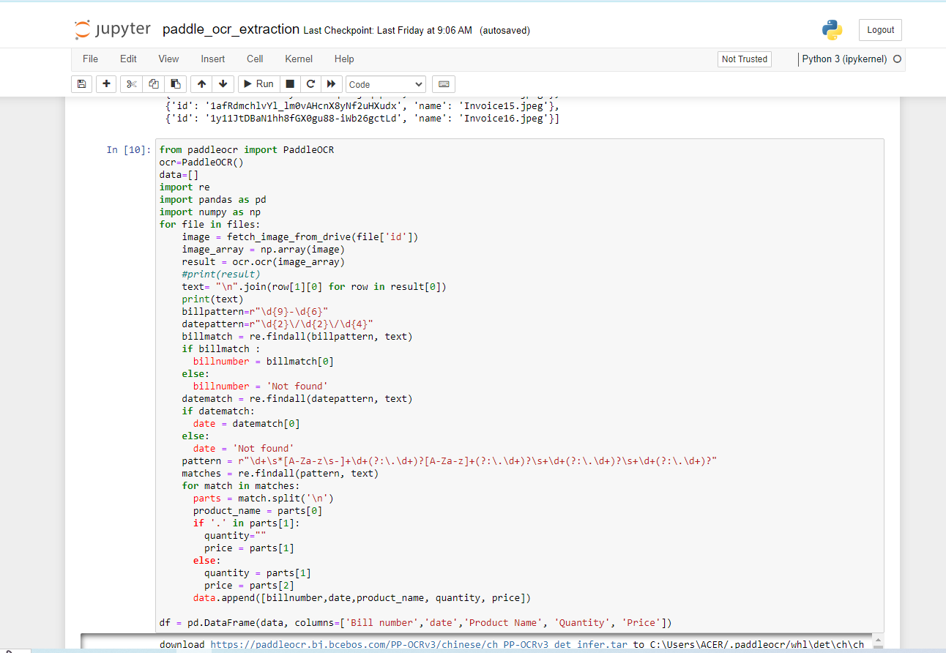
Best Model –
Paddle OCR is best model among easy ocr and tesseract OCR. By using relevent regex we can extract fields.
Notes:
Why Random Forest Regression is good?
A Random Forest Regression model is powerful and accurate. It usually performs great on many problems, including features with non-linear relationships
How is XGBoost different from random forest?
One of the most important differences between XG Boost and Random forest is that the XGBoost always gives more importance to functional space when reducing the cost of a model while Random Forest tries to give more preferences to hyperparameters to optimize the model..
n_estimators — the number of decision trees you will be running in the model

Slide 20
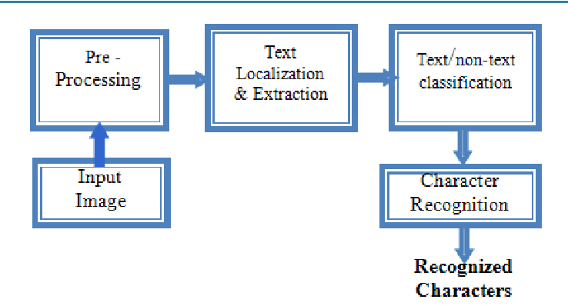
Model Deployment - Strategy

Slide 21
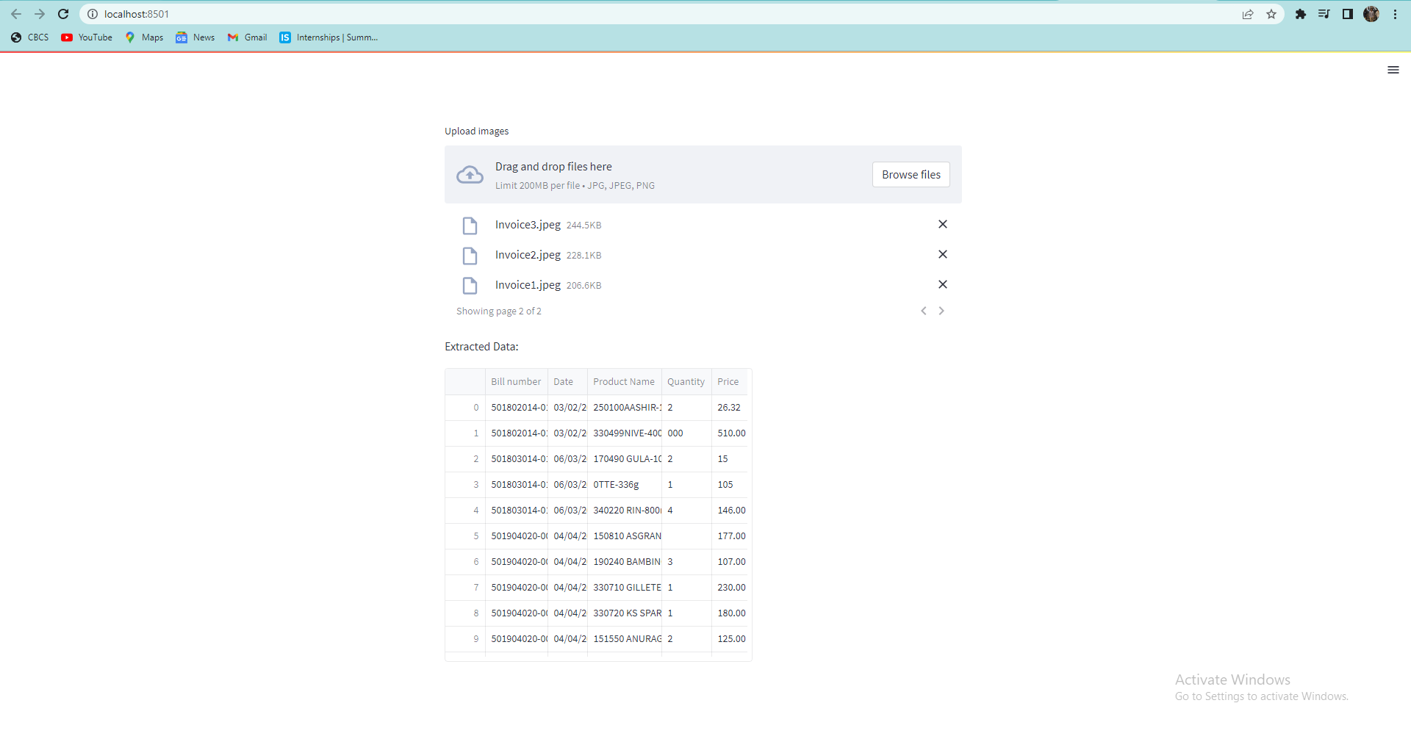
Screen shot of output

Slide 22
Challenges
Preprocessing the images before extraction.
Getting the required versions for OCR Extraction.
Pushing the data into databases

Slide 23
Future Scopes
Real-time OCR capabilities are highly desirable for various applications, such as live video analysis, augmented reality, or real-time translation.
Integrating PaddleOCR with document analysis techniques can enable more comprehensive document understanding. This could include tasks like document structure analysis, key-value extraction, or information extraction from specific document types.

Slide 24

Queries ?

Slide 25


